Slide 1
Machine learning model to predict the risk of readmission
- Sairam M & Karthick Ramnathan

Slide 2
BUSINESS scenario
Patients within the high-risk category are more likely to be readmitted within 30 days. In absence of any prediction model, hospitals are unable to identify and provide better and enhanced care to high-risk patients.
These hospital readmissions not only impact health outcomes, they’re also costly, accounting for more than $17 billion in avoidable Medicare expenditures annually. [1]
Hospitals are penalized by withholding up to 3% of regular reimbursements if they have a higher-than-expected number of readmissions within 30 days of discharge for six conditions. [1]
Chronic lung disease | Coronary artery bypass graft surgery | Heart attacks
Heart failure | Hip and knee replacements | Pneumonia

Slide 3




Assumptions & limitations
Prediction on Patient’s hospital Readmission
Data set from Kaggle. [2]
It is a “diabetic” encounter, that is, one during which any kind of diabetes was entered to the system as a diagnosis.
The length of stay was at least 1 day and at most 14 days.
Laboratory tests and Medications performed during the encounter.
Hidden Causes of Readmission [1]
High crime rate in neighbourhood Low Health Literacy Patients who depend on family transport Foods that meet their Dietary

Slide 4
ALGORITHM USED
Why Decision Tree?
Decision Tree algorithms can discover rich relationships between predictors and the response automatically.
It can easily handle more predictors than the number of response.

Slide 5
data modeling & Classification
Data is modeled based on LACE index scoring [3]
L - Length of stay of the index admission
A - Acuity of the admission. Specifically, if the patient is admitted through the Emergency Department vs. an elective admission
C - Co-morbidities, incorporating the Charlson Co-Morbidity Index.
E - Number of emergency visits of the patient in the year preceding the encounter.

Slide 6
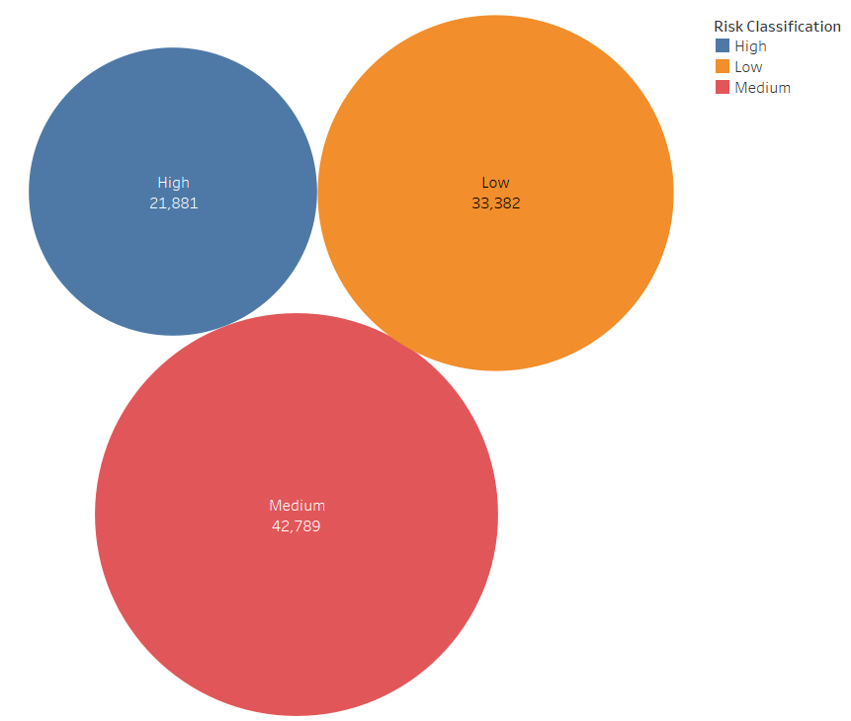
Risk classification
Risk Classification
Risk Score (0-5) “Low”
Risk Score (6-9) “Medium”
Risk Score (>=10) “High”

Slide 7
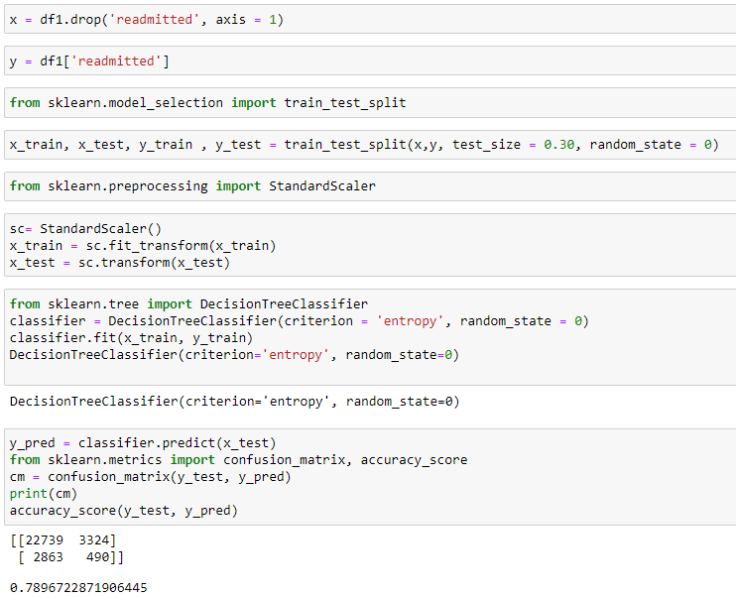
Code Snippets
Below given are some of the snippets of code that we used in the model
GitHub Link

Slide 8
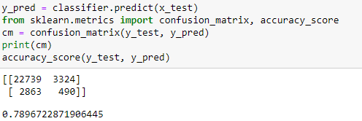
Model Output
Accuracy and Confusion Matrix using Decision tree algorithm
Our Model predicts at 78% accuracy with 22 % error

Slide 9
conclusion
Simple Prediction Model with huge benefit
Classifying the Patients into 3 Categories makes us easier to act proactively
Direct Users – Providers (Hospitals)
Indirect Users – Payers(Insurance Companies)
REFERENCES
[1]. https://healthitanalytics.com/news/preventable-hospital-readmissions-fall-dramatically-across-us
[2]. https://www.kaggle.com/code/iabhishekofficial/prediction-on-hospital-readmission
[3]. https://www.besler.com/lace-risk-score/#:~:text=LACE%20scores%20range%20from%201,10%20%3D%20High%20risk%20of%20readmission

